Slide 1

Sorting Algorithms Visualizer
ABHINAV LOHIA 2K19/CO/015
ABHINAV RANJITH 2K19/CO/016

Slide 2
Aim
To create a GUI program which visualize, analyse and compare all the data sorting algorithms

Slide 3
Abstract
This tool is an attempt to visualize and help to understand how some of the most famous sorting algorithms work. This tool is for the ones who want to see these algorithms under a different light and hopefully appreciate the processing and brain power behind these piece of genius that in many ways have changed the way we live.

Slide 4
Introduction
A sorting algorithm is an algorithm that organizes elements of a sequence in a certain order. Since the early days of computing, the sorting problem has been one of the main battlefields for researchers. Sorting visualizer makes it possible to compare as well as understand how different algorithms behave with different initial set of items. The reason behind this is not only the need of solving a very common task but also the challenge of solving a complex problem in the most efficient way.Algorithm takes an input, and provides output. We can also say that algorithm is a tool or a sequence of steps to solve computational problems . To design an algorithm various techniques and methodologies are applied. Sorting algorithms are design to order the data set into ascending or descending orders. Sorting algorithms are very important, as these algorithms are used to design other algorithms e.g. searching algorithms

Slide 5
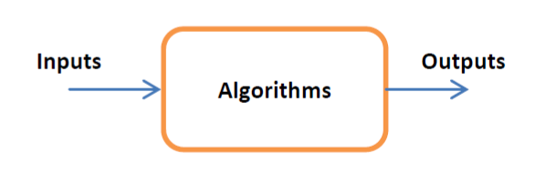
It is used in many importing applications, since the performance of sorting algorithm is very important issue . Due to this importance a number of sorting algorithms has been presented each with different constraints. Since we can formally define sorting as:
Input: A sequence of data set having n numbers of random order data 𝐴=(𝑎1,𝑎2,𝑎3… ,𝑎 𝑛−1 ,𝑎𝑛 )
Output: A permutation of the input sequence 𝐴′=(𝑎′1,𝑎′2,𝑎′3… ,𝑎′ 𝑛−1 ,𝑎′𝑛 ), such that 𝑎′1≤𝑎′2≤𝑎′≤,…,≤𝑎 𝑛−1 ≤𝑎𝑛 )

Slide 6
For example if the given sequence is (59, 41, 31, 41, 26, 58); then the output sequence of sorting algorithm will be (26, 31, 41, 41, 58, 59).Sorting is an intermediate and an important part of managing data. Due to their importance a number of sorting algorithms are proposed e.g. bubble sort, selection sort, insertion sort, quick sort, merge sort etc. Some of sorting algorithms are very simple e.g. bubble sort; while other are complex e.g. quick sort and merge sort
All sorting algorithms work for a specific environment. Some sorting algorithms works best on small data sets, some works good in a large data set, while others work good in a medium data set. The performance of a sorting algorithm is described by their complexity. Complexity of the algorithm is described by a standard notation big O as O(n); Where Big O represents the complexity of the algorithm, while n represents the number of elements in the database.

Slide 7
Sorting Algorithms Visualized:
.Insertion Sort
.Quick Sort
1
5
2
.Selection Sort
.Heap Sort
6
3
.Bubble Sort
4
.Merge Sort

Slide 8
Insertion Sort
Insertion sort algorithm is a simple and mostly used algorithm for small and mostly sorted arrays lists. This algorithm uses two same size array lists: one is sorted and one is unsorted. In each step of sorting a minimum element is found at unsorted list and placed it to the sorted list at its proper location. This algorithm uses two arrays since more memory is used, also more time consuming to find minimum element and copy it to new sorted array. This algorithm is relatively used for small and average data sets in place of bubble and selection sort algorithms. Insertion Sort algorithm is twice faster than bubble sort algorithm.

Slide 9
Insertion Sort - Algorithm
insertionSort(array)
mark first element as sorted
for each unsorted element X
'extract' the element X
for j <- lastSortedIndex down to 0
if current element j > X
move sorted element to the right by 1
break loop and insert X here
end insertionSort

Slide 10
Insertion Sort – Time Complexities
Worst Case Complexity: O(n^2)
Best Case Complexity: O(n)
Average Case Complexity: O(n^2)

Slide 11
Selection Sort
Selection Sort is a comparison sorting algorithm. This algorithm search the minimum element in the unsorted array or list and swap it to the first unsorted array location, with repeated iteration steps.This algorithm takes more time in finding minimum element in the array list .This algorithm is used for small list, but replaced by insertion sort. Selection sort uses more comparisons but less amount of data moving, since if data set has less key but large data sharing then Selection is sort is best.

Slide 12
Selection Sort - Algorithm
selectionSort(array, size)
repeat (size - 1) times
set the first unsorted element as the minimum
for each of the unsorted elements
if element < currentMinimum
set element as new minimum
swap minimum with first unsorted position
end selectionSort

Slide 13
Selection Sort – Time Complexities
Worst Case Complexity: O(n^2)
Best Case Complexity: O(n^2)
Average Case Complexity: O(n^2)

Slide 14
Bubble Sort
This sorting algorithm compares two adjacent elements and do swap operation if there is miss order found with repeated steps. This is also called a comparison sorting algorithm. The original bubble sort does more iteration even if the data set is sorted. For this bubble sort is used only for small number of data set, for large and average data sets this algorithm is impractical. The main advantage of bubble sort is its simplicity, and ease of implementation; but the code inefficient as do more iterations. In bubble sort algorithm the number of iterations is same for all cases, since this algorithm is not practical.

Slide 15
Bubble Sort - Algorithm
bubbleSort(array)
swapped <- false
for i <- 1 to indexOfLastUnsortedElement-1
if leftElement > rightElement
swap leftElement and rightElement
swapped <- true
end bubbleSort

Slide 16
Bubble Sort – Time Complexities
Worst Case Complexity: O(n^2)
Best Case Complexity: O(n)
Average Case Complexity: O(n^2)

Slide 17
Merge Sort
It is a divide and conqueror algorithm, with advantage of ease of merging lists with new sorted lists.
Merge sort uses the following three steps to sort a array list:
1. Divide : if size of array is greater than 1, then split it into two equal half size sub arrays.
2. Conquer: sort both sub arrays by recursion.
3. Merging : Combine both sorted sub arrays into original size array. This will gives a complete sorted array.
Merge sort is more suitable for large and worst case, but it uses more memory as compare to other divide and conqueror algorithms.

Slide 18
Merge Sort - Algorithm
MergeSort(A, p, r):
if p > r
return
q = (p+r)/2
mergeSort(A, p, q)
mergeSort(A, q+1, r)
merge(A, p, q, r)

Slide 19
Merge Sort – Time Complexities
Worst Case Complexity: O(n * log n)
Best Case Complexity: O(n * log n)
Average Case Complexity: O(n * log n)

Slide 20
Quick Sort
Quick sort is a divide and conqueror algorithm uses recursion to sort the data. It is also called a comparison sort. It uses a programmer selected pivot to sort the data list. Quick Sort Algorithm is divided into two parts:
First part is a procedure QUICK to use the reduction steps of the algorithm.
Second part uses the QUICK procedure to sort the elements in the array list.

Slide 21
Quick Sort - Algorithm
partition(array, leftmostIndex, rightmostIndex)
set rightmostIndex as pivotIndex
storeIndex <- leftmostIndex - 1
for i <- leftmostIndex + 1 to rightmostIndex
if element[i] < pivotElement
swap element[i] and element[storeIndex]
storeIndex++
swap pivotElement and element[storeIndex+1]
return storeIndex + 1
quickSort(array, leftmostIndex, rightmostIndex)
if (leftmostIndex < rightmostIndex)
pivotIndex <- partition(array,leftmostIndex, rightmostIndex)
quickSort(array, leftmostIndex, pivotIndex)
quickSort(array, pivotIndex + 1, rightmostIndex)

Slide 22
Quick Sort – Time Complexities
Worst Case Complexity: O(n^2)
Best Case Complexity: O(n * log n)
Average Case Complexity: O(n * log n)

Slide 23
Heap Sort
Quick sort is a divide and conqueror algorithm uses recursion to sort the data. It is also called a comparison sort. It uses a programmer selected pivot to sort the data list. Quick Sort Algorithm is divided into two parts:
First part is a procedure QUICK to use the reduction steps of the algorithm.
Second part uses the QUICK procedure to sort the elements in the array list.

Slide 24
Heap Sort - Algorithm
partition(array, leftmostIndex, rightmostIndex)
set rightmostIndex as pivotIndex
storeIndex <- leftmostIndex - 1
for i <- leftmostIndex + 1 to rightmostIndex
if element[i] < pivotElement
swap element[i] and element[storeIndex]
storeIndex++
swap pivotElement and element[storeIndex+1]
return storeIndex + 1
quickSort(array, leftmostIndex, rightmostIndex)
if (leftmostIndex < rightmostIndex)
pivotIndex <- partition(array,leftmostIndex, rightmostIndex)
quickSort(array, leftmostIndex, pivotIndex)
quickSort(array, pivotIndex + 1, rightmostIndex)

Slide 25
Heap Sort – Time Complexities
Worst Case Complexity: O(n^2)
Best Case Complexity: O(n * log n)
Average Case Complexity: O(n * log n)

Slide 26
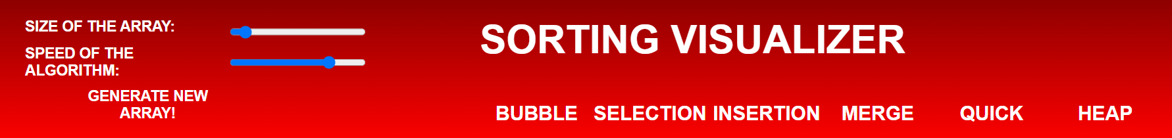
Methodology and Main-work
The web-based animation tool, Sorting Visualizer has been made using HTML, CSS and JavaScript. The tool aims to provide user an experience to see the actual working of the various sorting algorithms and appreciate the processing and brain power behind these piece of genius.
The tool Even though the underlying back-end code went through a drastic refactor midway through the implementation, the overall design and layout of the user-interface components has remained the same. The interface has ten components: a canvas area and a navigation panel which consist of 7 buttons and two slider input for array size and speed.

Slide 27
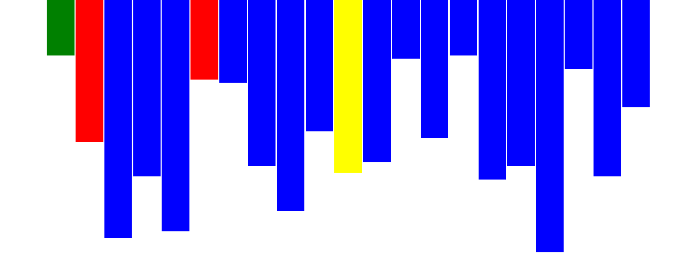
This allows the user to generate a random array of size in between 20 to 150 and witness the unsorted array bring sorted according to the sort and the speed of visualization selected by the user. Elements of the array are represented as bars with their heights representing their numeric value and a certain color code has been used to which is stated as follows:
Blue : element in its incorrect index
Yellow : the algorithm is looking at that element(iterating)
Red : the algorithm is changing that particular element
Green : element in its correct index/position

Slide 28
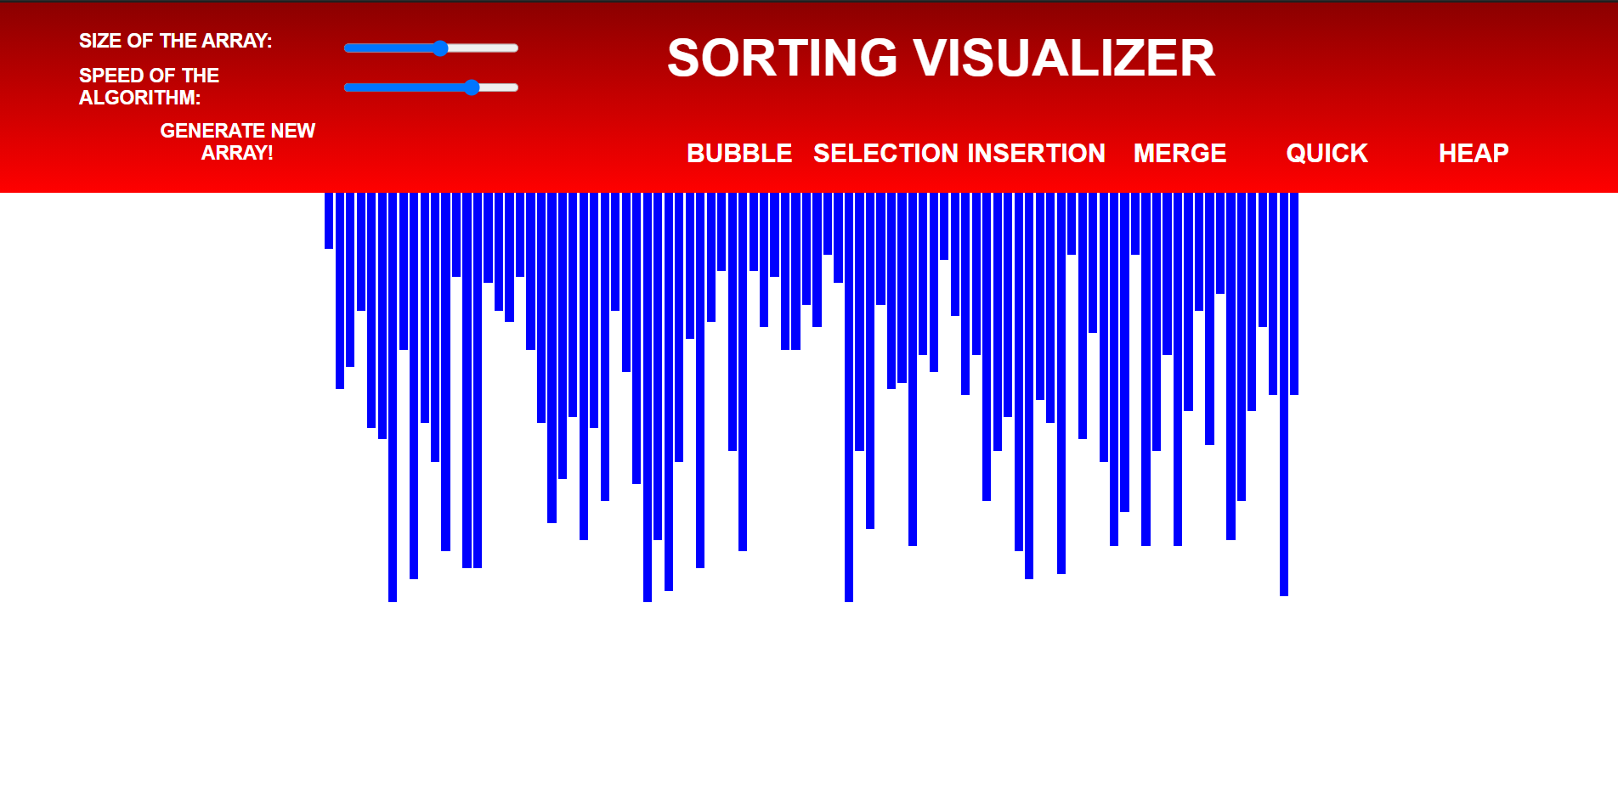
This is the final web-based animation tool:

Slide 29
Conclusion
Through much time and effort, we have successfully created a working web-based animation tool for visualizing the following sorting algorithms: Bubble Sort, Selection Sort, Insertion Sort, Merge Sort, Quick Sort and Heap Sort. In the course of this project we learnt how to code a web platform using HTML, CSS and JavaScript.
Efficient sorting is important for optimizing the efficiency of other algorithms hence having a good grasp on them is very important. Further in the course of learning algorithms one will discover advanced facets of a language along with programming design patterns that will give you an edge as a developer
So with the help of our tool we hope one can see these algorithms under a different light and hopefully appreciate the processing and brain power behind these piece of genius.

Slide 30
Bibliography
www.researchgate.net
www.geeksforgeeks.org
https://ieeexplore.ieee.org

Slide 31
Thank You

